Slide 1
MOSES
BY FAITH
HEBREWS 11:23-29

Slide 2
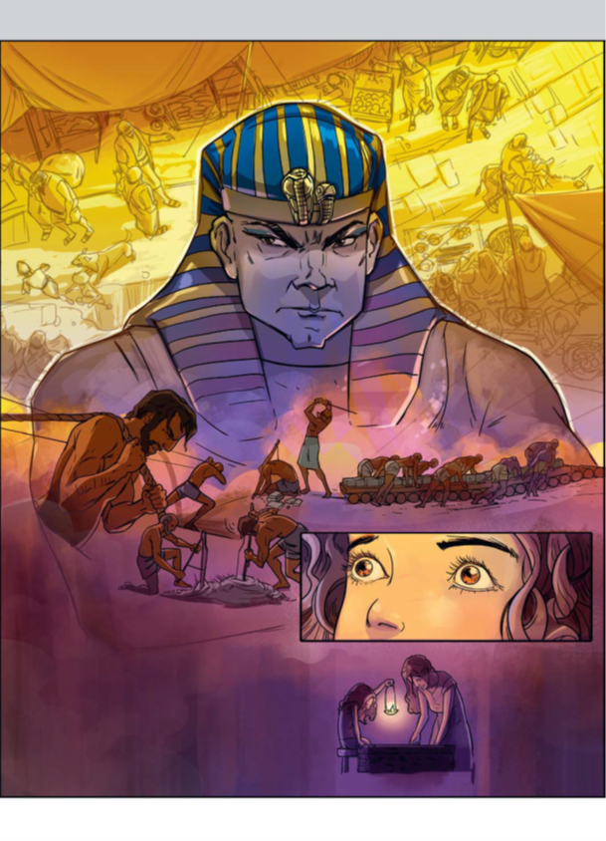
Pharaoh’s (the worldly) command.
Jw.org

Slide 3
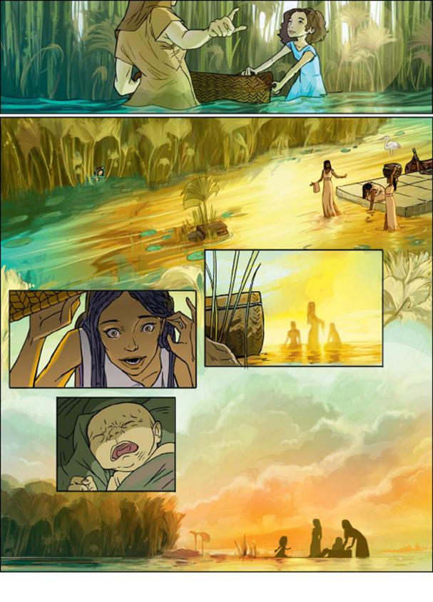
by Faith Moses’ parents hid him.
Jw.org

Slide 4
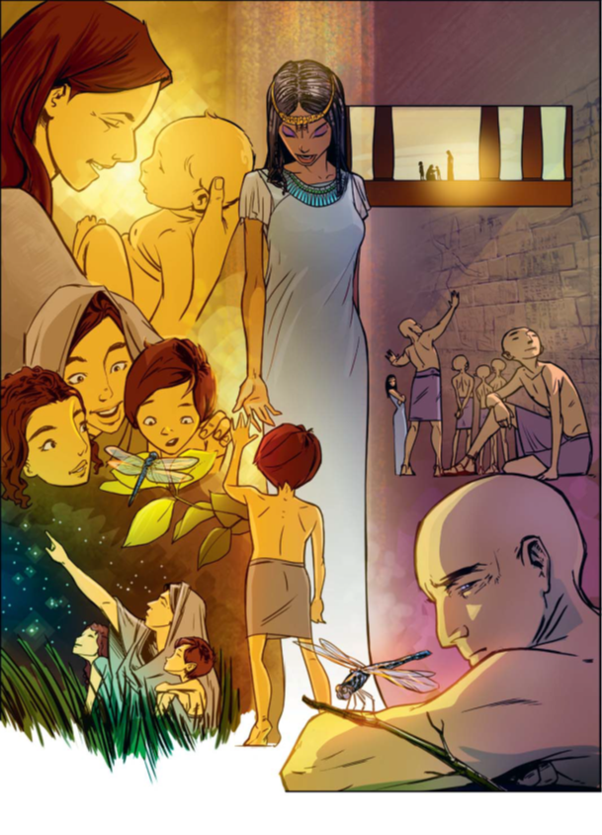
  The Faith of Moses was found in his choice to follow God.
Jw.org

Slide 5
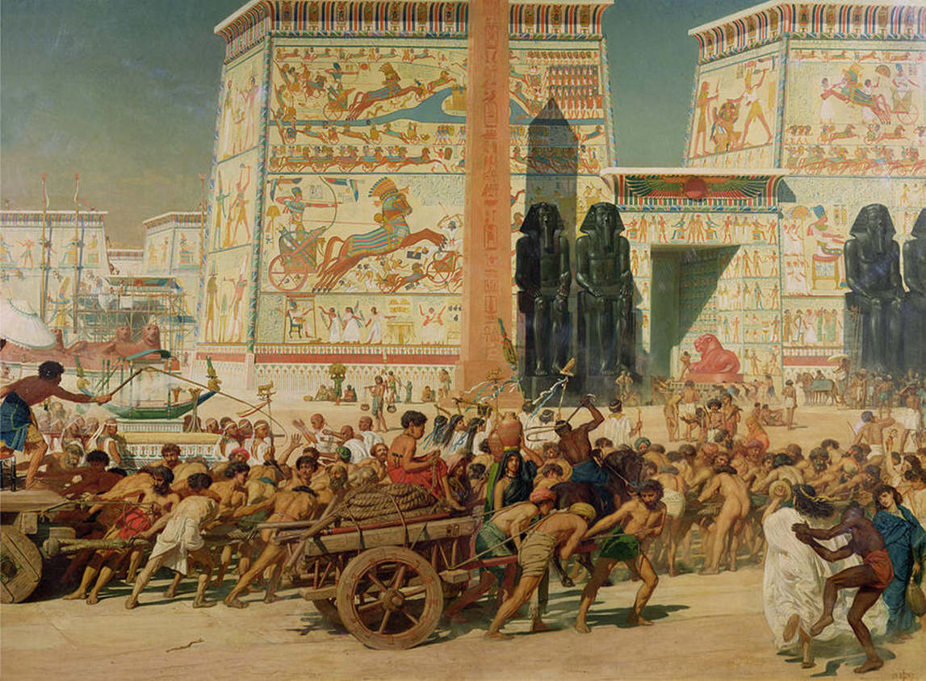
  Faith to Suffer Affliction with the people of God.

Slide 6
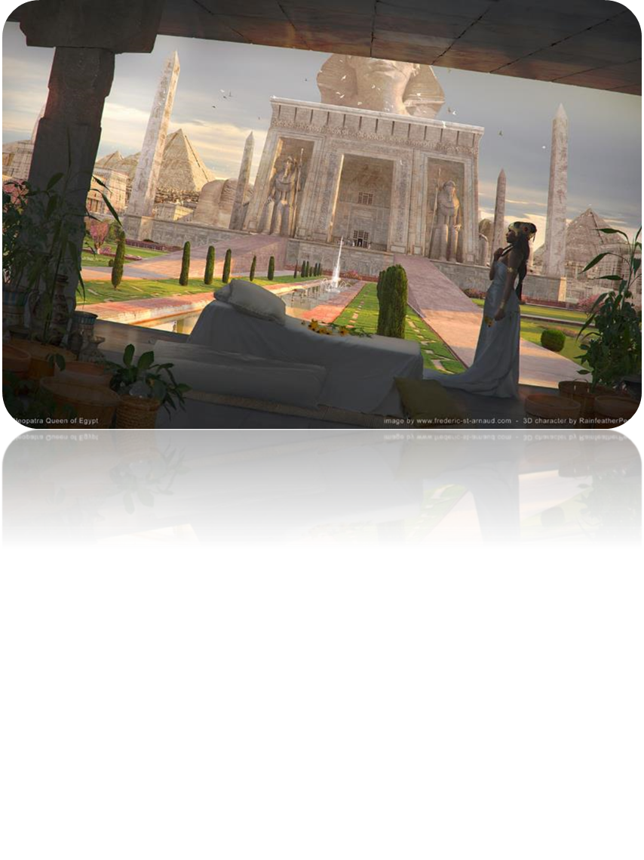
  Faith to follow!
Jw.org

Slide 7
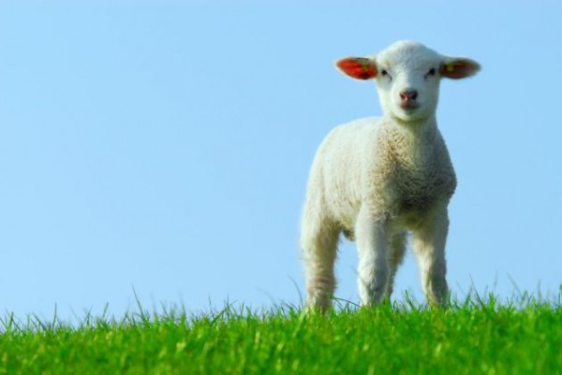
  Faith to apply the blood!
    vs 26-27 shows Moses’ DECISION to follow Christ.
    vs 28 shows the DELIVERANCE of Moses and the Hebrew nation.
Jw.org

Slide 8
The Faith of Moses’ Followers!

Slide 9
Israel learned to follow in faith because God designed FAITH to be CONTAGIOUS!
all that God has called you to should be lived out so as to cause others to follow.

Slide 10
Don’t miss the picture of faith for every believer given to us in the deliverance of Israel.
  Salvation: Passover
  Baptism: Red Sea

Slide 11
1 Cor 10:1-2 Moreover, brethren, I would not that ye should be ignorant, how that all our fathers were under the cloud, and all passed through the sea; (2) And were all baptized unto Moses in the cloud and in the sea;

Slide 12
Don’t miss the picture of faith for every believer given to us in the deliverance of Israel.
  Salvation: Passover
  Baptism: Red Sea
  Sanctification: worked out in the wilderness wandering leading to entering into God’s promised rest.

Slide 13
Heb 4:10-11 For he that is entered into his rest, he also hath ceased from his own works, as God did from his. 11 Let us labour therefore to enter into that rest, lest any man fall after the same example of unbelief.

Slide 14
Conclusion! Believing God (your faith) brings you through what destroys the unbelieving!

Slide 15
Phil 1:27-30 Only let your conversation be as it becometh the gospel of Christ: that whether I come and see you, or else be absent, I may hear of your affairs, that ye stand fast in one spirit, with one mind striving together for the faith of the gospel; (28) And in nothing terrified by your adversaries: which is to them an evident token of perdition, but to you of salvation, and that of God. (29) For unto you it is given in the behalf of Christ, not only to believe on him, but also to suffer for his sake; (30) Having the same conflict which ye saw in me, and now hear to be in me.
2 Tim 2:12; Rom 8:15-17

Slide 16
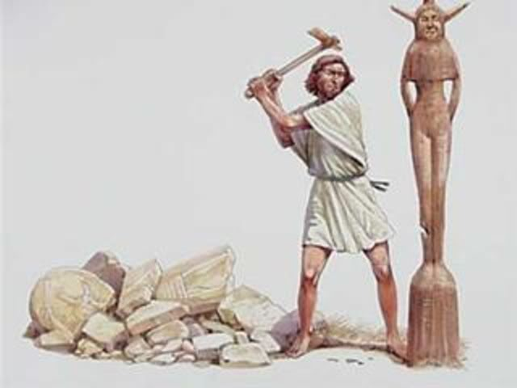
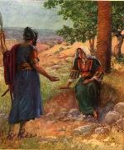
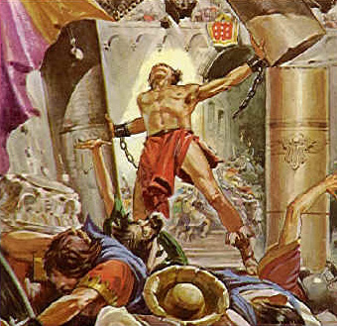
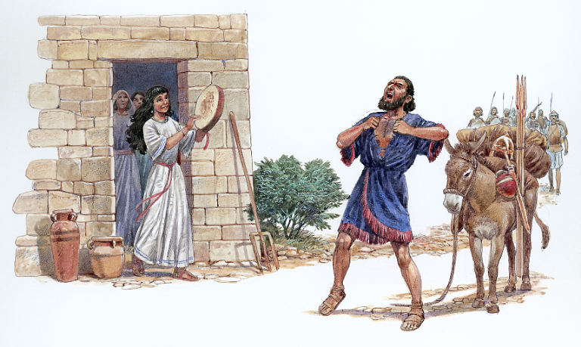
  Weak Men – who learned to trust God.

Slide 17
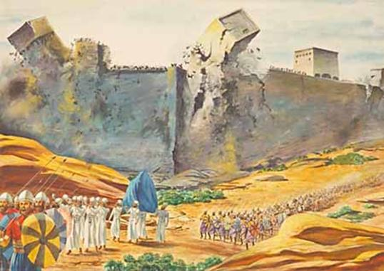
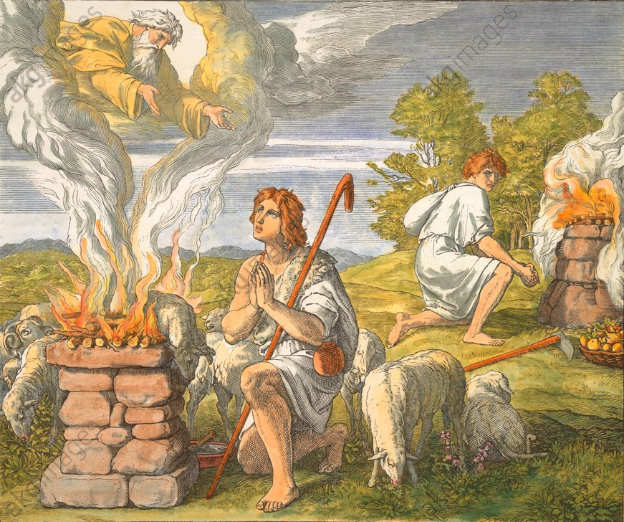
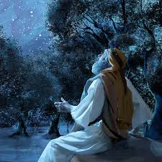
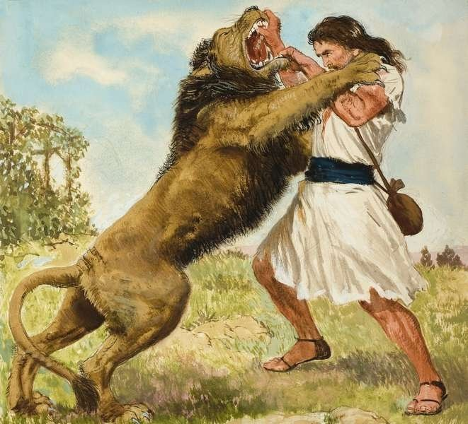
  Weak Men – Who Worked Wonders to the glory of God.

Slide 18
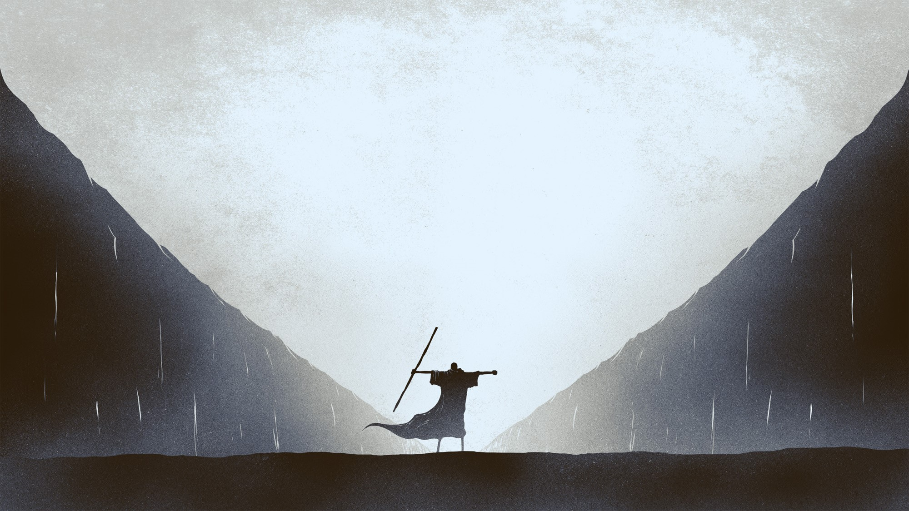
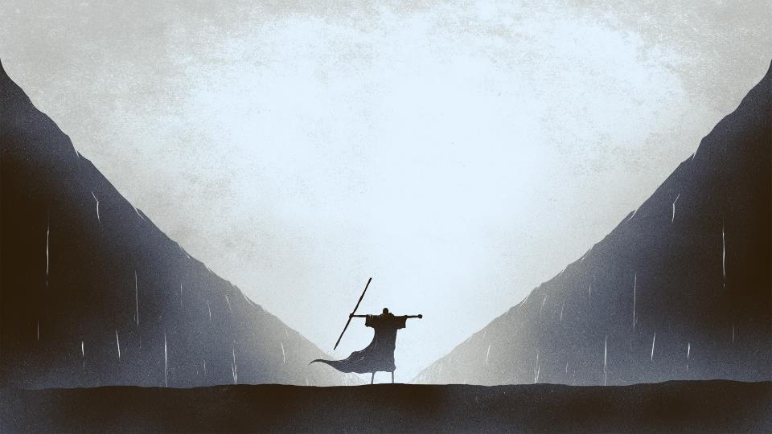
MOSES
BY FAITH
HEBREWS 11:23-29

